Slide 1
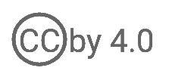
WSO2 API Manager 4.0.0 Developer Fundamentals
Product Security
WSO2 Training

Slide 2
Configuring Keystores
Three different keystores :
Primary : Used for signing and encryption of data which is externally exposed.
E.g., Signing SAML response, OAuth ID Token Signing and Signing JWTs.
Secondary : Used for authenticating communication over SSL/TLS.
E.g., servlet transport(used for webapps), Synapse transport(used in gateway), thrift, binary and JMS.
Internal : Used for encrypting internal critical data including passwords and other confidential information in configuration files.
Can be configured from the <API-M_HOME>/repository/conf/deployment.toml.
Notes:
WSO2 products use asymmetric cryptography by default for the purposes of authentication and data encryption.
In asymmetric cryptography, keystores (with key pairs and certificates) are created and stored for the product.
Keystore is a repository where private keys and certificates can be stored.
Possible to have multiple keystores so that the keys used for different use cases are kept unique.

Slide 3
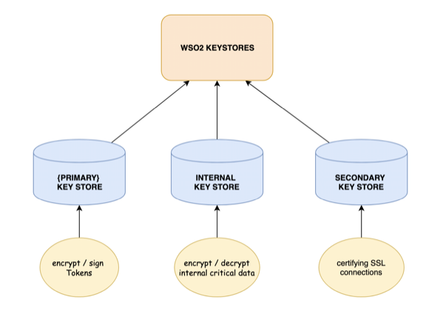
Configuring Keystores

Slide 4
Maintaining Logins and Passwords
Recover admin password
Use the <APIM_HOME>/bin/chpasswd.sh script to recover the super admin password.
Linux
<APIM_HOME>/bin/chpasswd.sh
Windows
<APIM_HOME>\bin\chpasswd.bat
Changing the super admin password
The super admin credentials are configured in <APIM_HOME>/repository/conf/deployment.toml file.
[super_admin]
username = "your-name"
password = "your-password"
Documentation Link - Maintaining Login Details
Notes:
Important
In the first start up, the super admin is created in the configured user store. After that, during the login, password validation is done from the user store.
To change the password afterwards, it should be done through the API Manager management console.
Log in to management console as the super admin (https://localhost:9443/carbon),
Go to Users and Roles > List > Users
Click on the Change Password button in the Actions section of admin user.
Enter the new password and click Save.

Slide 5
Securing Passwords
Secure-Vault
Store encrypted passwords and map them with aliases, which are used in configuration files instead of the actual passwords.
These encrypted passwords will be decrypted and resolved during runtime only.
For example, if the admin user password is admin, you can define an alias (such as admin_password) and map that particular alias to the actual password (admin). At runtime, the product will look up this alias in the secure vault, decrypt it, and use the mapped password.

Slide 6
Encrypting passwords in configuration files
Working with encrypted passwords
Encrypting passwords in product configuration files
Encrypting secured endpoint passwords
Encrypting passwords for mediation flow
Using encrypted passwords in mediation flow
Link - Working with Encrypted Passwords

Slide 7
Encrypting Passwords with Cipher Tool
The instructions below explain how plain text passwords in configuration files can be encrypted using the secure vault implementation :
Encrypting passwords using the automated process.
Encrypting passwords using the manual process.
Changing already encrypted passwords.
Resolving already encrypted passwords.
Link - Encrypting Passwords with Cipher Tool
Notes:
These files are stored in the <API-M_HOME>/conf/security directory

Slide 8
Encrypting passwords using the automated process
This automated process can be used for passwords that are used in configuration files.
Add a [secrets] section in the deployment.toml file with the passwords and aliases that needs to be encrypted.
Replace the actual password usages with the alias.
Run the ciphertool to encrypt the passwords.
On Linux: ./ciphertool.sh -Dconfigure
On Windows: ./ciphertool.bat -Dconfigure

Slide 9
Encrypting passwords using the automated process
Secret Definition
Replace Actual Password with Alias
Format
alias = “[password]”
[secrets]
admin_password = "[admin]"
keystore_password = "[wso2carbon]"
key_password = "[wso2carbon]"
truststrore_password = "[wso2carbon]"
[super_admin]
username="admin"
password="$secret{admin_password}"
[keystore.tls]
password = "$secret{keystore_password}"
key_password = "$secret{key_password}"
[truststore]
password = "$secret{truststrore_password}"

Slide 10
Encrypting passwords using the manual process
This manual process can be used for encrypting any password in a configuration file.
The log4j2.properties file and jndi.properties file are two such files which require the manual password encryption process.

Slide 11
Encrypting passwords using the manual process
You can encrypt the credentials by providing a primary key password while running the Cipher tool.
You will receive an encrypted value as a result. (e.g., Encrypted value is:
gaMpTzAccMScaHllsZLXspm1i4HLI0M/srL5pB8jyknRKQ2zT7NuCvt1+qEkElRLgwlrohz3lkuE0KFuapXrCSs5pxfGMOLn4/k7dNs2SlwbsG8C++/
ZfUuft1Sl6cqvDRM55fQwzCPfybl713HvKu3oDaJ9VKgSbvHlQj6zqzg=
Replace the plaintext with the encrypted values in the relevant places.

Slide 12
Encrypting passwords for mediation flow
Encrypt passwords manually as shown before.
Select Browse under Resources to access the registry browser and go to the /_system/config/repository/components/secure-vault location.
Add the aliases and the encrypted value as a property.

Slide 13
Using encrypted passwords in mediation flow
Instead of hard coding the admin user's password as <Password>admin</Password>, you can encrypt and store the password using the AdminUser. Password alias as follows: <Password>{wso2:vault-lookup('AdminUser.Password')}</Password>.

Slide 14
General Data Protection Regulation(GDPR)
Prepacked Forget-Me tool : can be used to remove identities of an external user who is deleted according to the system administrator’s request.
This tool removes user identities stored in the database and also in log files in order to meet GDPR requirements.
Usage : On Linux/mac OS: ./forgetme.sh -U <username>
On Windows: forgetme.bat -U <username>

Slide 15
Transport Level Security
Disabling weak ciphers
Changing the server name in HTTP response headers
Documentation Link: TLS Security
Notes:
A cipher is an algorithm for performing encryption or decryption. When you set the sslprotocol of your server to TLS, the TLS and the default ciphers get enabled without considering the strength of the ciphers.
This is a security risk as weak ciphers, also known as EXPORT ciphers, can make your system vulnerable to attacks such as the Logjam attack on Diffie-Hellman key exchange. The Logjam attack is also called the Man-in-the-Middle attack. It downgrades your connection's encryption to a less-secured level (e.g., 512 bit) that can be decrypted with sufficient processing power.
It is recommended to change this by configuring the server name in the deployment.toml file.

Slide 16
Mutual SSL
Secure your backend by enabling mutual SSL between the API Gateway and your backend.
Export the certificates.
Enable dynamic SSL profiles.
Documentation Link : Mutual SSL

Slide 17
User Account Management
Password Recovery
Account Locking
Password Policies
Documentation Link: User Account Management

